Slide 1
Heart and Soul Nebulae
IC1805 & IC1845
Both in constellation Cassiopeia

Slide 2
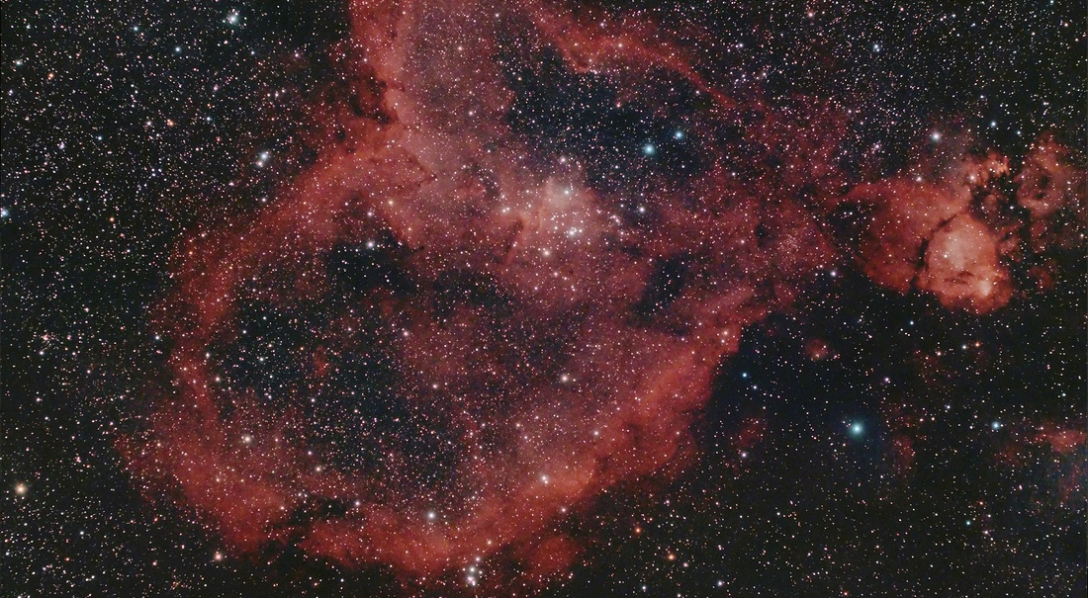
Heart Nebula, IC 1805, Sh2-190
Notes:
http://en.wikipedia.org/wiki/Heart_Nebula The Heart Nebula, IC 1805, Sh2-190, lies some 7500 light years away from Earth and is located in the Perseus Arm of the Galaxy in the constellation Cassiopeia. This is an emission nebula showing glowing gas and darker dust lanes. The nebula is formed by plasma of ionized hydrogen and free electrons.
The very brightest part of this nebula (the knot at the right) is separately classified as NGC 896, because it was the first part of this nebula to be discovered.
The nebula's intense red output and its configuration are driven by the radiation emanating from a small group of stars near the nebula's center. This open cluster of stars known as Melotte 15 contains a few bright stars nearly 50 times the mass of our Sun, and many more dim stars that are only a fraction of our Sun's mass. The cluster used to contain a microquasar that was expelled millions of years ago.

Slide 3
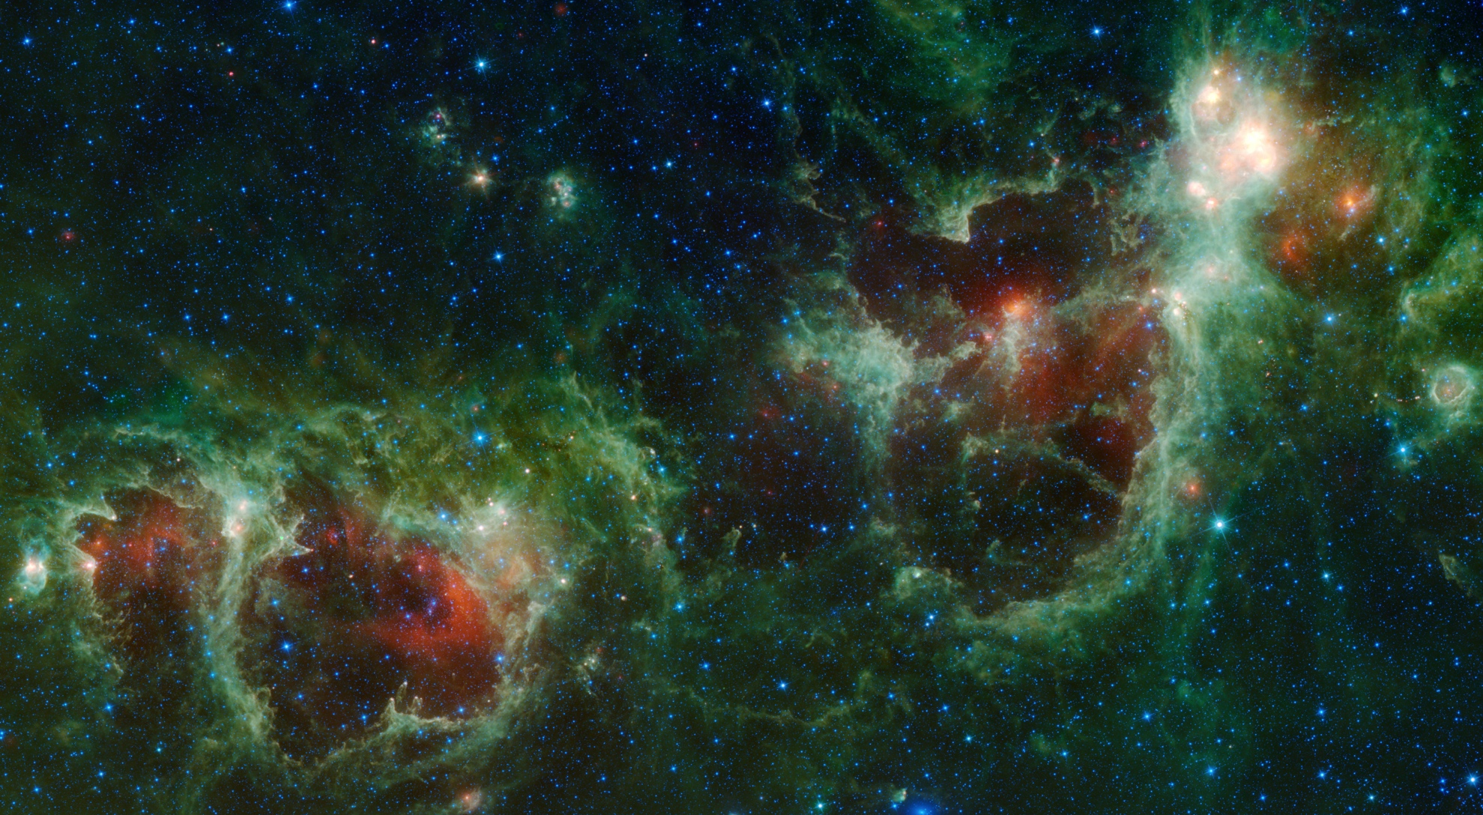
The Heart and Soul nebulae are seen in this infrared mosaic from NASA's WISE telescope.
Notes:
http://en.wikipedia.org/wiki/Heart_Nebula The Heart and Soul nebulae are seen in this infrared mosaic from NASA's WISE telescope.

Slide 4
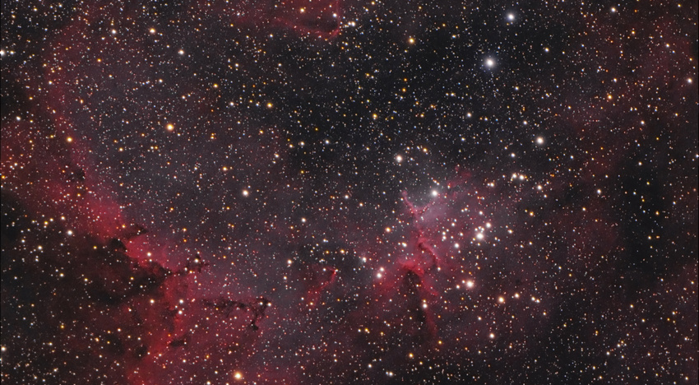
Open Cluster Melotte 15 at the core of IC 1805.
Notes:
http://en.wikipedia.org/wiki/Heart_Nebula
Open Cluster Melotte 15 at the core of IC 1805.
This open cluster of stars known as Melotte 15 contains a few bright stars nearly 50 times the mass of our Sun, and many more dim stars that are only a fraction of our Sun's mass. The cluster used to contain a microquasar that was expelled millions of years ago.

Slide 5
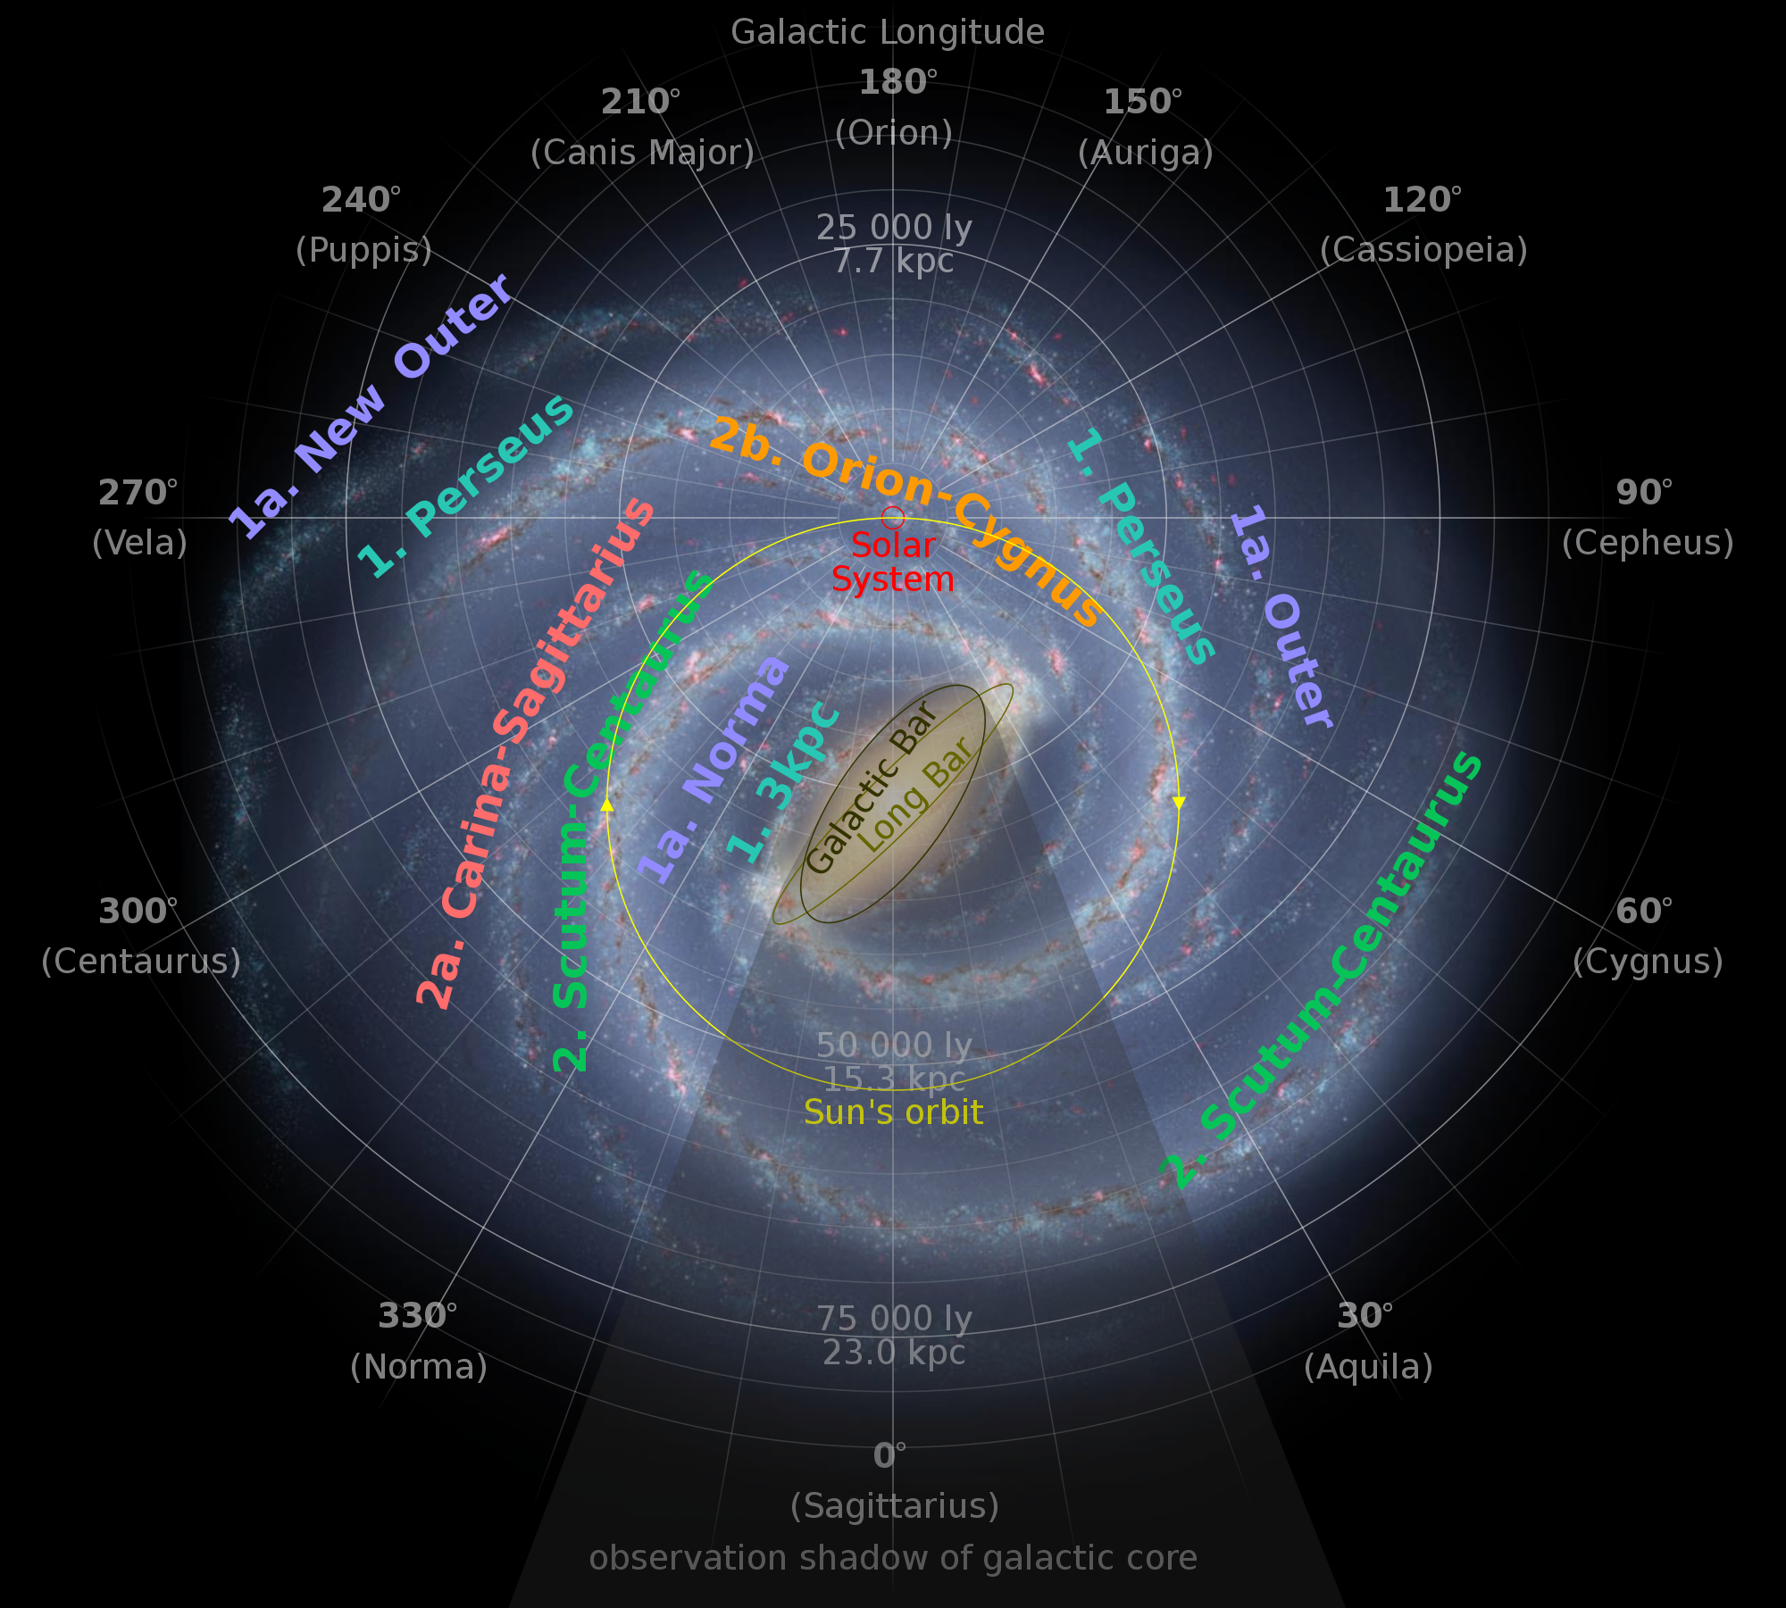
Diagram of Our Galaxy, the Milky Way
Notes:
http://en.wikipedia.org/wiki/Perseus_Arm
The Perseus Arm is one of two major spiral arms of the Milky Way galaxy. The second major arm is called Scutum–Centaurus Arm. Perseus Arm begins from the distal end of the long Milky Way.^{[1]}
The Milky Way is a barred spiral galaxy with two major arms and a number of minor arms or spurs.^{[1]} The Perseus Spiral Arm, with a radius of approximately 10,700 parsecs, is located between the minor Cygnus and Carina–Sagittarius Arms.^{[1]} It is named after its proximity to the constellation Perseus.
There is speculation that the local spur known as the Orion–Cygnus Arm, which includes the solar system and Earth and is located inside of Perseus Arm,^{[1]} is a branch of it, but this is unconfirmed.

